Slide 1


AI in Cyber Threat Detection
Enhancing security through intelligent automation
Payman Ghorbani
MSc Cyber Security – Module 1 Final Assignment
Notes:
Greeting - Introducing myself
Today I’ll explore how Artificial Intelligence is transforming cyber threat detection, with real-world examples and practical insights. This is a 15-minute presentation to fulfil Part B of the final assignment for the module Launching into Computing.

Slide 2
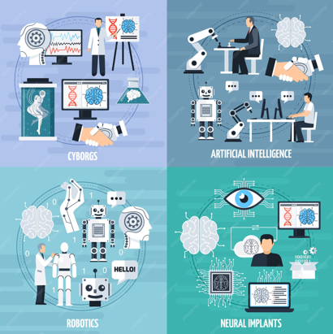
What Is AI ?
AI refers to systems that learn from data to make decisions
Uses machine learning, pattern recognition, and automation
Enables intelligent responses without explicit programming
Widely applied in cybersecurity for threat detection and response
(Okdem & Okdem, 2024)
Notes:
Define AI briefly (machine learning, pattern recognition, automation)
- Explain its role in cybersecurity: anomaly detection, threat prediction, automated response

Slide 3
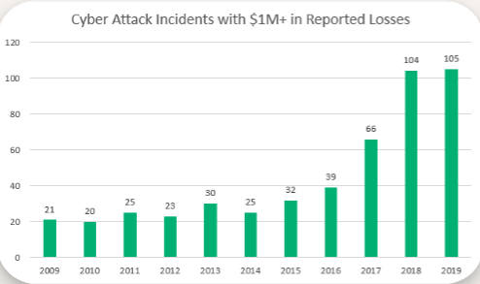
Why it matter
Rising volume and complexity of cyber threats
Human limitations in manual monitoring
AI’s speed, scalability, and adaptability
(Ofusori et al., 2024)33333
financial losses from cyber attacks over time (Sectigo Store, 2020)

Slide 4
AI systems follow a workflow (Suggu, 2025)
Data Collection
Feature Extraction
Threat Detection
Model Training
Uses techniques like supervised learning, unsupervised learning, and neural networks

Slide 5
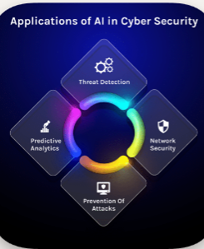
Application in Cyber Threat Detection
- Intrusion Detection Systems (IDS)
- Malware classification
- Phishing detection
- Behavioural analytics
- (Salem et al., 2024)
AI applications in cybersecurity(AROBS, 2024)

Slide 6

Case Study - Darktrace
- Company: Darktrace (UK-based cybersecurity firm)
- Technology: Self-learning AI that models normal behaviour across networks
- Application: Detects insider threats and zero-day exploits
- Example: Flagged a compromised device exfiltrating data without triggering signature-based alerts
- (Rayport & Lefort, 2024)

Slide 7

Case Study – IBM Watson for cybersecurity
- Technology: IBM Watson uses NLP and machine learning to analyse threat intelligence
- Benefit: Accelerates incident response by automating analysis
- Integration: Works with SIEM platforms to enhance detection and decision-making
- (IBM Security, 2024)
Logo source: PNGItem (2024)

Slide 8
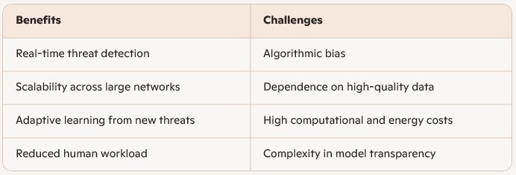
Benefits vs Challenges
(Kumar et al., 2024)

Slide 9
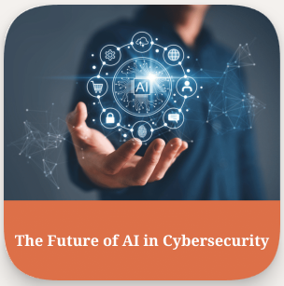
Future Outlook
- AI-driven autonomous response: Real-time, self-initiated threat mitigation without human intervention
- Quantum-safe algorithms: Cryptographic standards resistant to quantum computing attacks
- Ethical AI in cybersecurity: Transparent (Explainable AI (XAI)), accountable
, and privacy (GDPR)-respecting AI deployment
(Adkins et al., 2025; NIST, 2024; KPMG, 2025)

Slide 10
Conclusion - AI is essential for modern cyber defense
- AI is essential for modern cyber defence
- Real-world tools like Darktrace and IBM Watson demonstrate its impact
- Challenges remain — bias, data quality, ethical concerns
- Innovation continues toward autonomous, quantum-safe, and ethical AI
(Adkins et al., 2025; IBM Security, 2024; Kumar et al., 2024)

Slide 11

Thank you
pg25304@essex.ac.uk

Slide 12
References A-Q
Adkins, H., Evron, G., & Schneier, B. (2025). Autonomous AI Hacking and the Future of Cybersecurity. CSO Online. Available at: https://www.csoonline.com/article/4069075/autonomous-ai-hacking-and-the-future-of-cybersecurity.html (Accessed: 19 October 2025).
AROBS. (2024). The Impact of Artificial Intelligence and Machine Learning on Cybersecurity. Available at: https://arobs.com/blog/the-impact-of-artificial-intelligence-and-machine-learning-on-cybersecur
IBM Security. (2024). Watson for Cybersecurity: AI-Powered Threat Intelligence. Available at: https://www.ibm.com/security/artificial-intelligence (Accessed: 19 October 2025).
KPMG. (2025). The Ethical Use of AI in Cybersecurity: Balancing Security and Privacy in the Digital Age. Available at: https://kpmg.com/us/en/articles/2025/ethical-ai-cybersecurity-balancing-security-privacy-digital-age.html (Accessed: 19 October 2025).
Kumar, R., Singh, A., & Sharma, P. (2024). Artificial Intelligence in Cybersecurity: Benefits, Challenges, and Ethical Implications. International Journal of Cyber Ethics, 9(1), pp. 45–62. Available at: https://ijce.org/articles/ai-cybersecurity-benefits-challenges (Accessed: 19 October 2025).
NIST. (2024). NIST Releases First 3 Finalized Post-Quantum Encryption Standards. Available at: https://www.nist.gov/news-events/news/2024/08/nist-releases-first-3-finalized-post-quantum-encryption-standards (Accessed: 19 October 2025).

Slide 13
References Continued R-Z
Ofusori, L., Bokaba, T., & Mhlongo, S. (2024). Artificial Intelligence in Cybersecurity: A Comprehensive Review and Future Direction. Applied Artificial Intelligence, 38(1), e2439609. https://www.tandfonline.com/doi/pdf/10.1080/08839514.2024.2439609
Okdem, S., & Okdem, S. (2024). Artificial Intelligence in Cybersecurity: A Review and a Case Study. Applied Sciences, 14(22), 10487. https://www.mdpi.com/2076-3417/14/22/10487
PNGItem. (2024). IBM Watson Logo Transparent PNG. Available at: https://www.pngitem.com/pimgs/m/413-4135751_ibm-watson-logo-png-transparent-png.png (Accessed: 19 October 2025).
Rayport, J. F., & Lefort, A. (2024). Darktrace: Scaling Cybersecurity and AI (A). Harvard Business School Case Collection. Available at: https://www.hbs.edu/faculty/Pages/item.aspx?num=65635 (Accessed: 19 October 2025).
Salem, A. H., Azzam, S. M., Emam, O. E., & Abohany, A. A. (2024). Advancing Cybersecurity: A Comprehensive Review of AI-Driven Detection Techniques. Journal of Big Data, 11, Article 105. Available at: https://journalofbigdata.springeropen.com/articles/10.1186/s40537-024-00957-y (Accessed: 19 October 2025).
Sectigo Store. (2020). 42 Cyber Attack Statistics by Year: A Look at the Last Decade. Available at: https://sectigostore.com/blog/42-cyber-attack-statistics-by-year-a-look-at-the-last-decade/ (Accessed: 19 October 2025).
Suggu, S. K. (2025). Agentic AI Workflows in Cybersecurity: Opportunities, Challenges, and Governance. Journal of Information Systems Engineering and Management, 10(52s). Available at: https://jisem-journal.com/index.php/journal/article/view/10767 (Accessed: 19 October 2025).

